Slide 1
COURESE NAME: COMPILER DESIGN AND CONSTRUCTION LAB
COURSE CODE: CSEL-3202
COURSE TEACHER: DR. SELINA SHARMIN (Associate Professor, CSE, JnU)
ASSIGNMENT
MD. MORSHED ALI
ID: B170305013

Slide 2
Problem No: 01
Write a C program to recognize strings under 'a', 'a*b+', 'abb'.

Slide 3
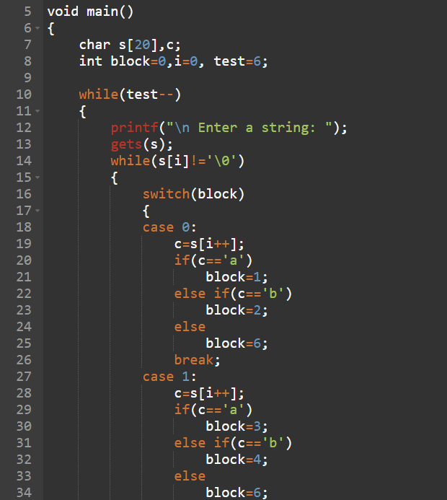
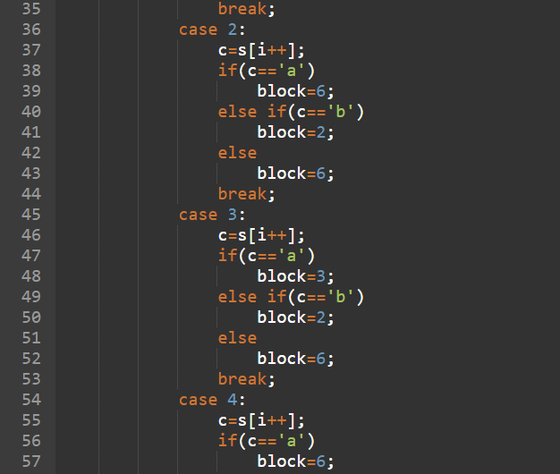
Pseudo Code

Slide 4
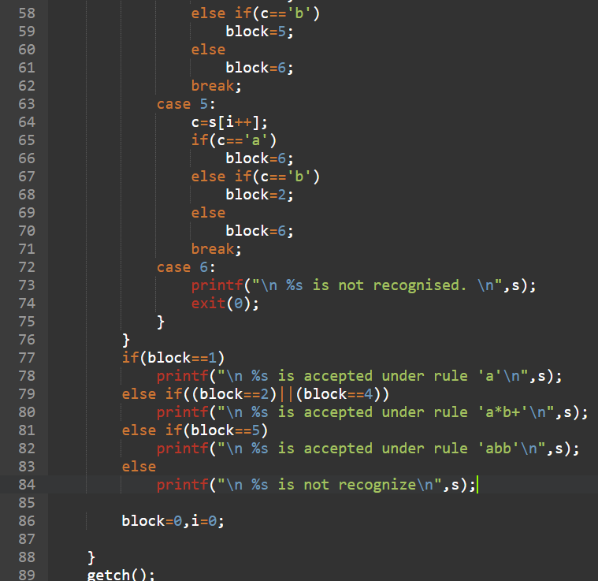
Pseudo Code
For raw code:
https://github.com/1998morshed/Computer-Science-Course-Materials/blob/main/compiler2.c

Slide 5
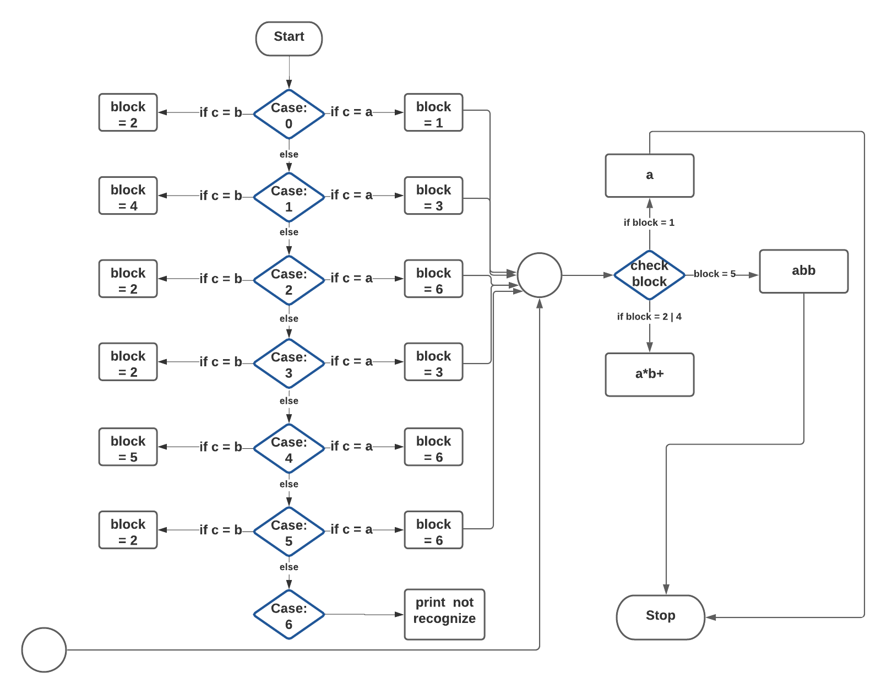
Flowchart

Slide 6
Problem No: 02

Slide 7
Part : 01
Evaluate regular expression. For simplicity, assume that there is a fixed set of regular expressions. Do not consider out of these. But you must not use any built-in method or package in your implementation. If you need any method, you will write that. In Regular Expression (RE), '*' means occurrence of zero of more characters, '+' indicates happening of one or more characters, '?' means only once or not at all occurrence, '[ ]' indicates happening of inclusive characters, '^' indicates that next characters will not be used in the pattern, '[a-d]{3}' indicates that valid string will be exactly of length 3 inclusively using a, b, c, d. The following table contains a fixed set of RE that will be used in our assignment.
Description | RE | Valid | Invalid
Email Address | Find yourself | abc@gmail.com csejnu@gmail.com lab.cse@yahoo.com | 123abc@gmail.com cse.jnu@gmail.com lab.cse@yaho0.com
Web Address | Find yourself | www.abc.com www.csejnu.com www.cse123.com | ww1.abc.com wwww.csejnu.ac
Digit | Find yourself | 4.560 | 0.0.1
Identifier | Find yourself | Abc1$ | 5a

Slide 8
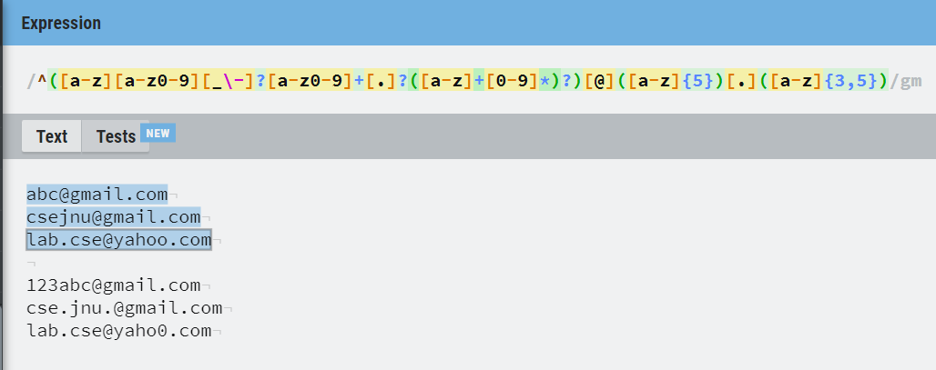
Regular Expression
Email Adress:
^([a-z][a-z0-9][_\-]?[a-z0-9]+[.]?([a-z]+[0-9]*)?)[@]([a-z]{5})[.]([a-z]{3,5})
Output Snap using online IDE: https://regexr.com/

Slide 9
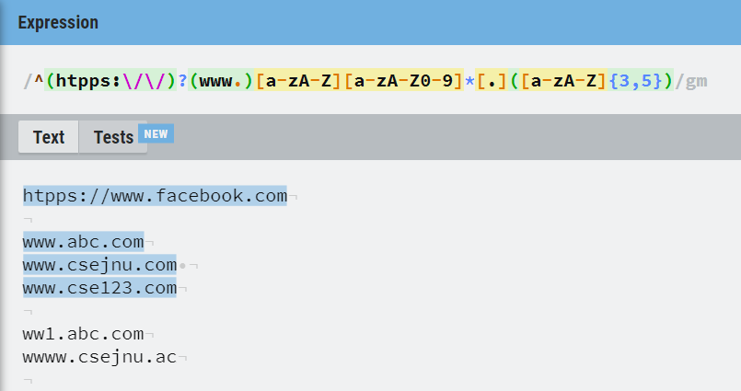
Regular Expression
Web Adress:
^(htpps:\/\/)?(www.)[a-zA-Z][a-zA-Z0-9]*[.]([a-zA-Z]{3,5})
Output Snap using online IDE: https://regexr.com/

Slide 10
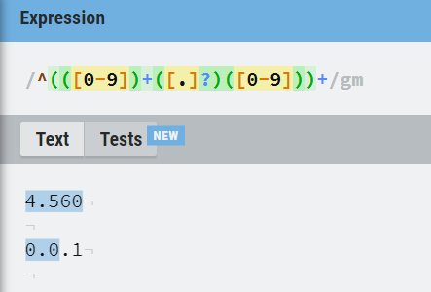
Regular Expression
Digit:
^(([0-9])+([.]?)([0-9]))+
Output Snap using online IDE: https://regexr.com/

Slide 11
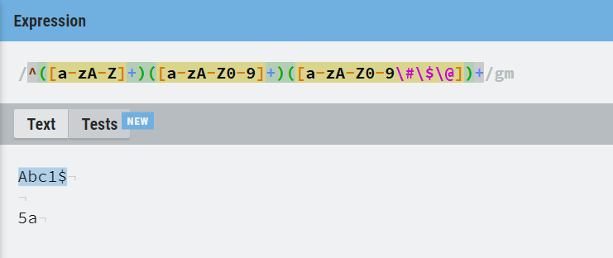
Regular Expression
ID:
^([a-zA-Z]+)([a-zA-Z0-9]+)([a-zA-Z0-9\#\$\@])+
Output Snap using online IDE: https://regexr.com/

Slide 12

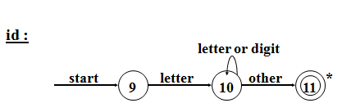
Part: 02
 | Transition Diagram
Email Address | Find yourself
Web Address | Find yourself
Digit (Positive real numbers)
Id (Identifier)
*

Slide 13
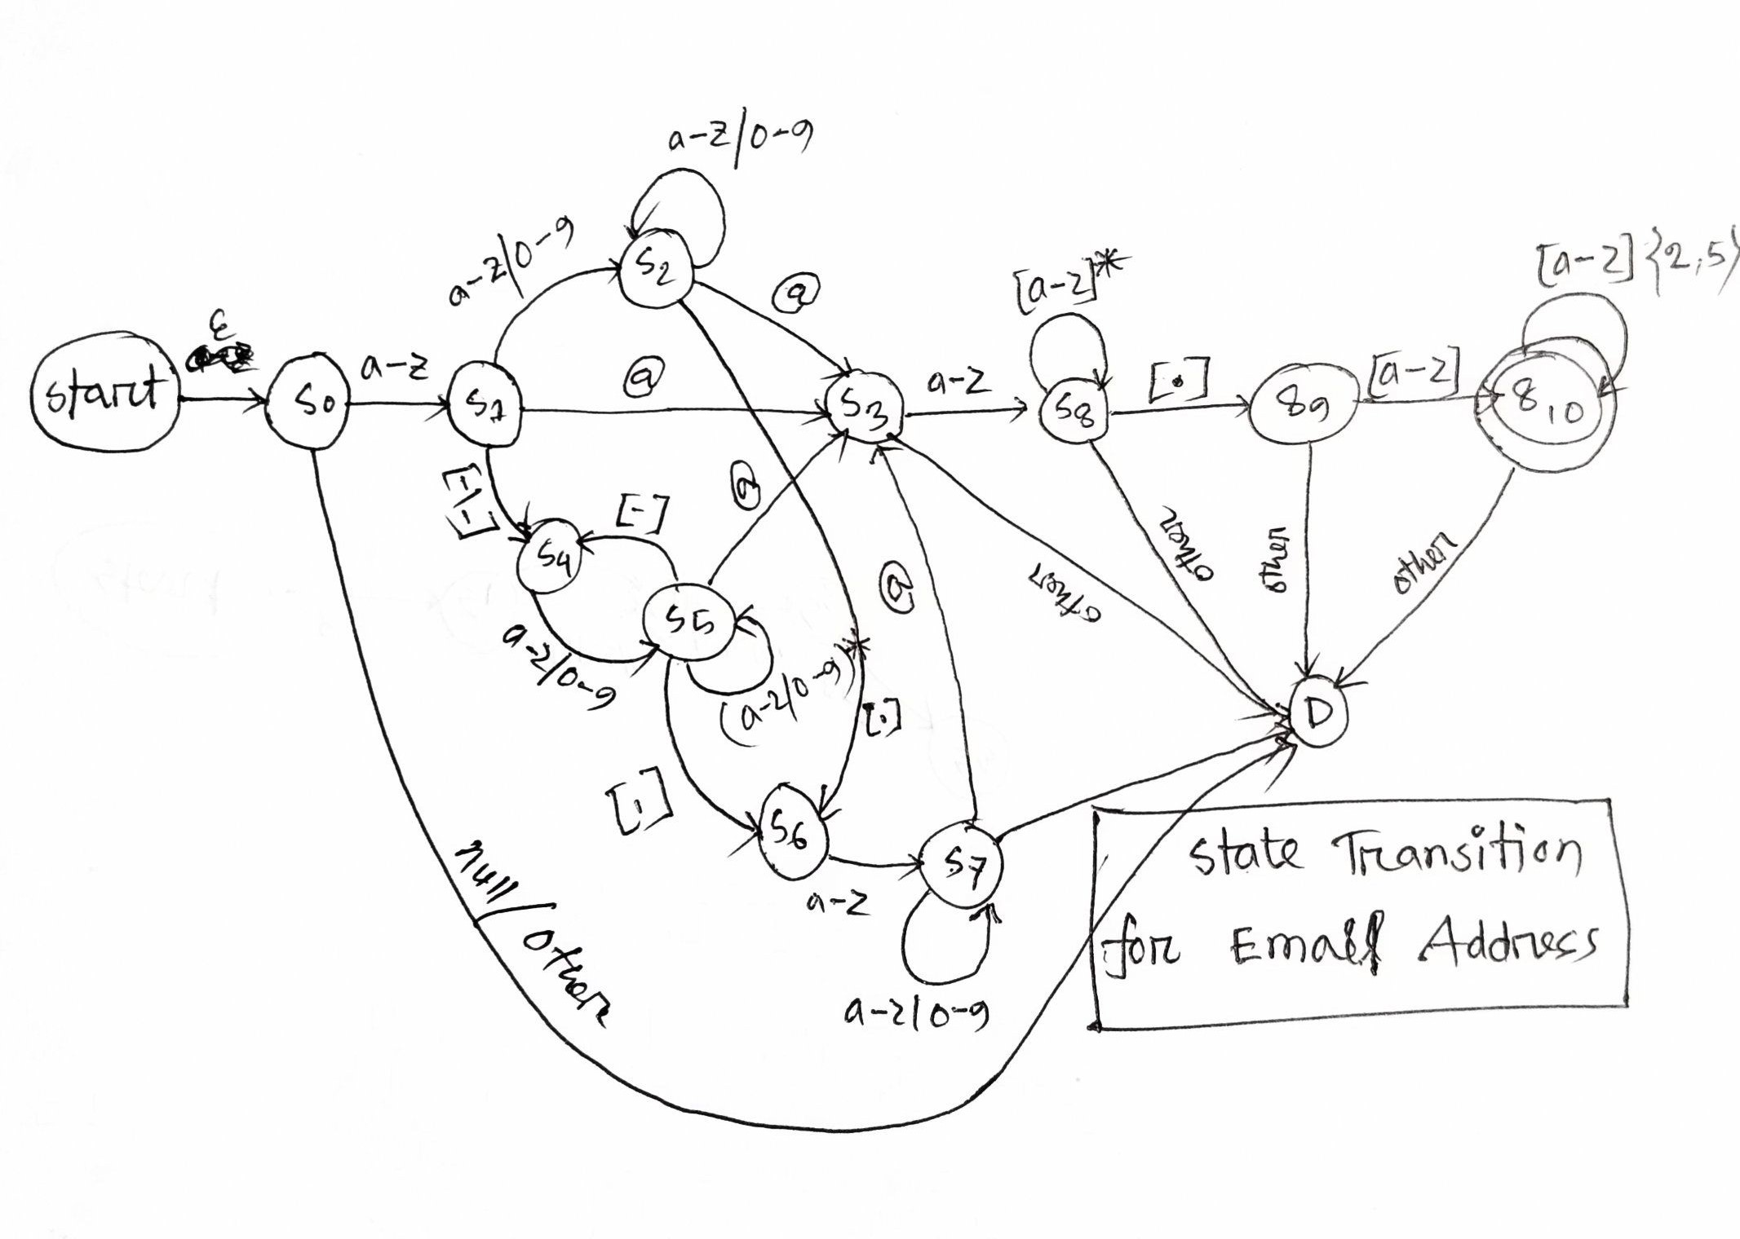
Transition Diagram
Transition Diagram for Email Address

Slide 14
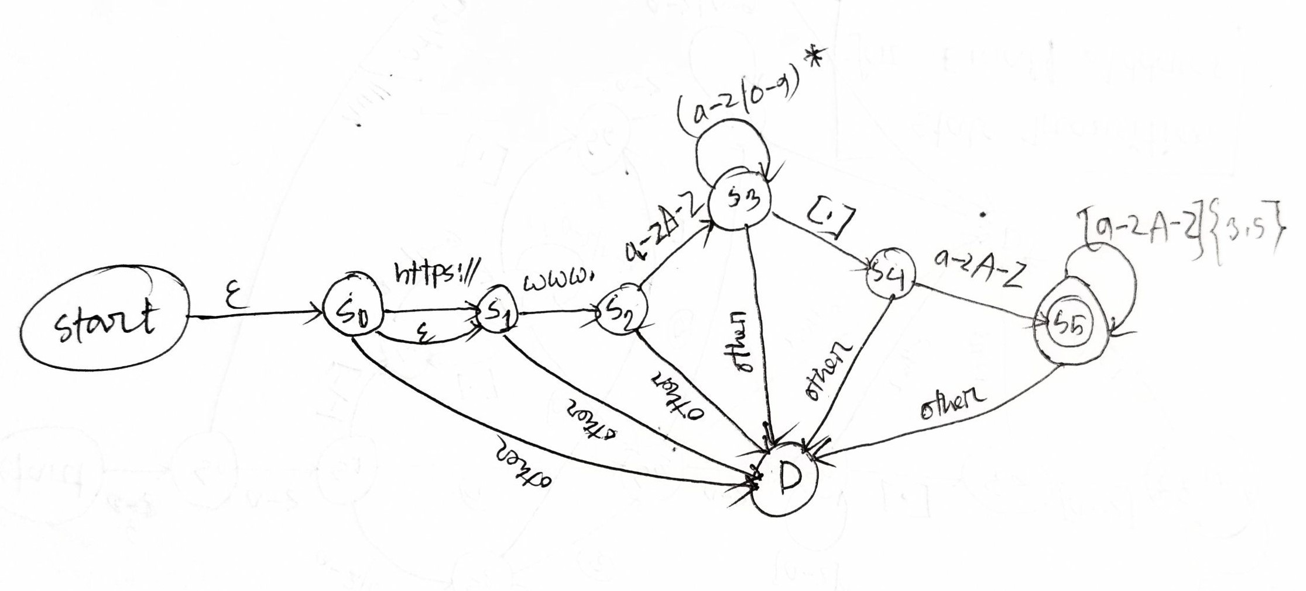
Transition Diagram
Transition Diagram for Web Address

Slide 15
Part: 03
User will be asked first to input an integer value n followed by n lines of Strings. You have to find out whether it is email or web address or digit or Id along with its line number. Otherwise, say 'INVALID' with zero index. Remember, in no way you can use any kind of built in Regular Expression for this task.
Sample Input: | Sample Output:
2 csejnu@gmail.com www.csejnu.com | Email, 1 Web, 2
5 cse.jnu@gmail.com lab.cse@yahoo.com lab.cse@gmail.com wwww.csejnu.ac www.cse23.com | INVALID, 0 Email, 1 Email, 1 INVALID, 0 Web, 2
2 4.560 Abc1$ | Digit, 3 Id, 4

Slide 16
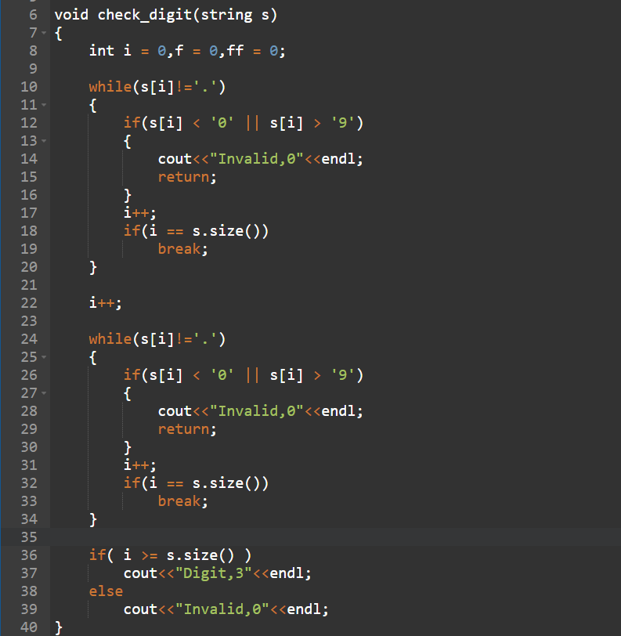
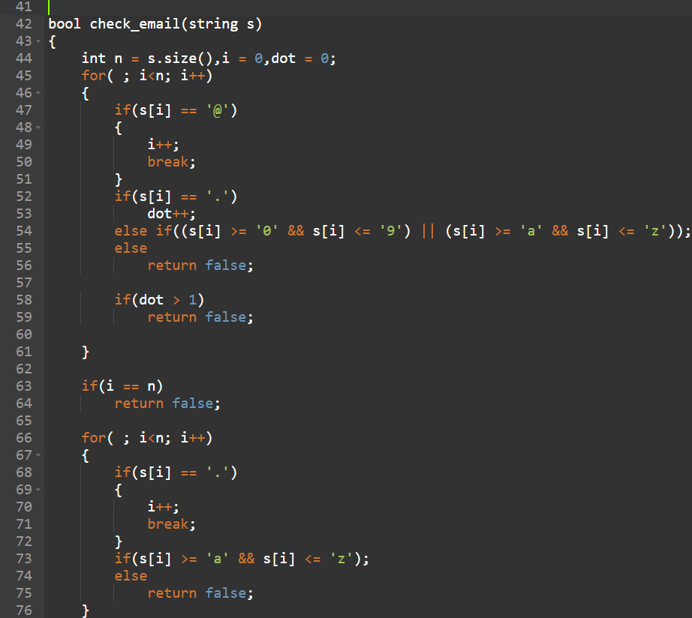
Pseudo Code

Slide 17
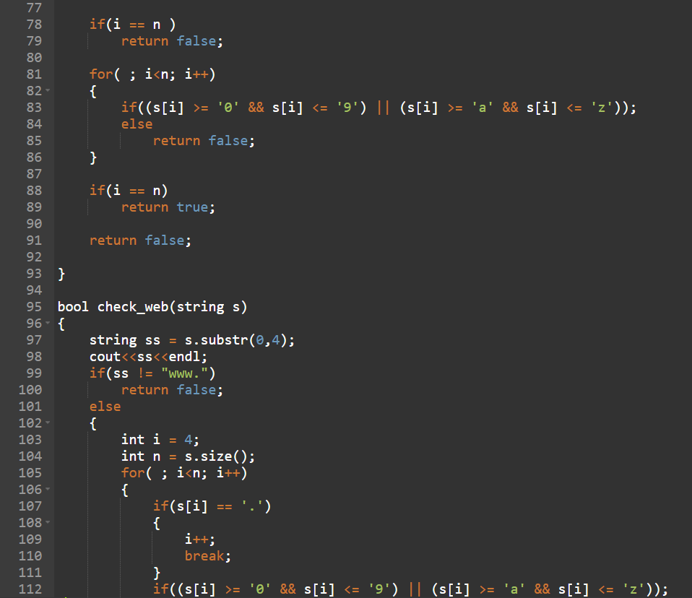
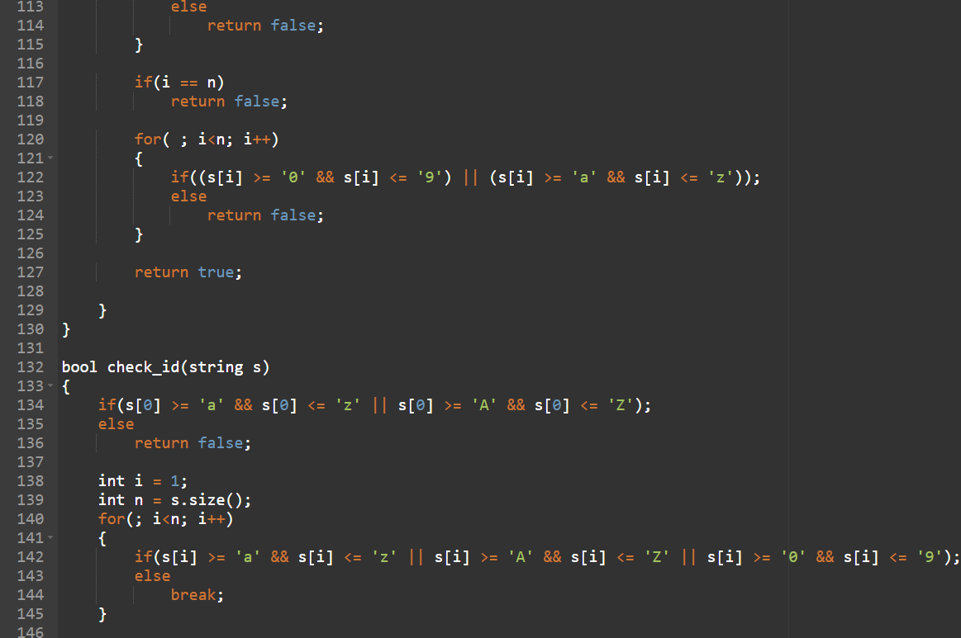
Pseudo Code

Slide 18
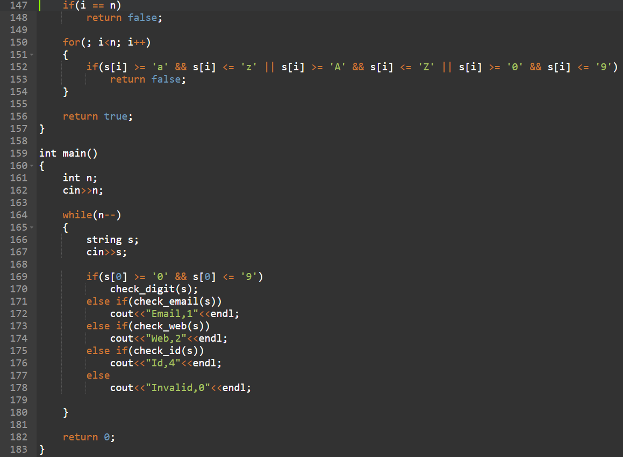
Pseudo Code
For raw code:
https://github.com/1998morshed/Computer-Science-Course-Materials/blob/main/compiler.cpp

Slide 19
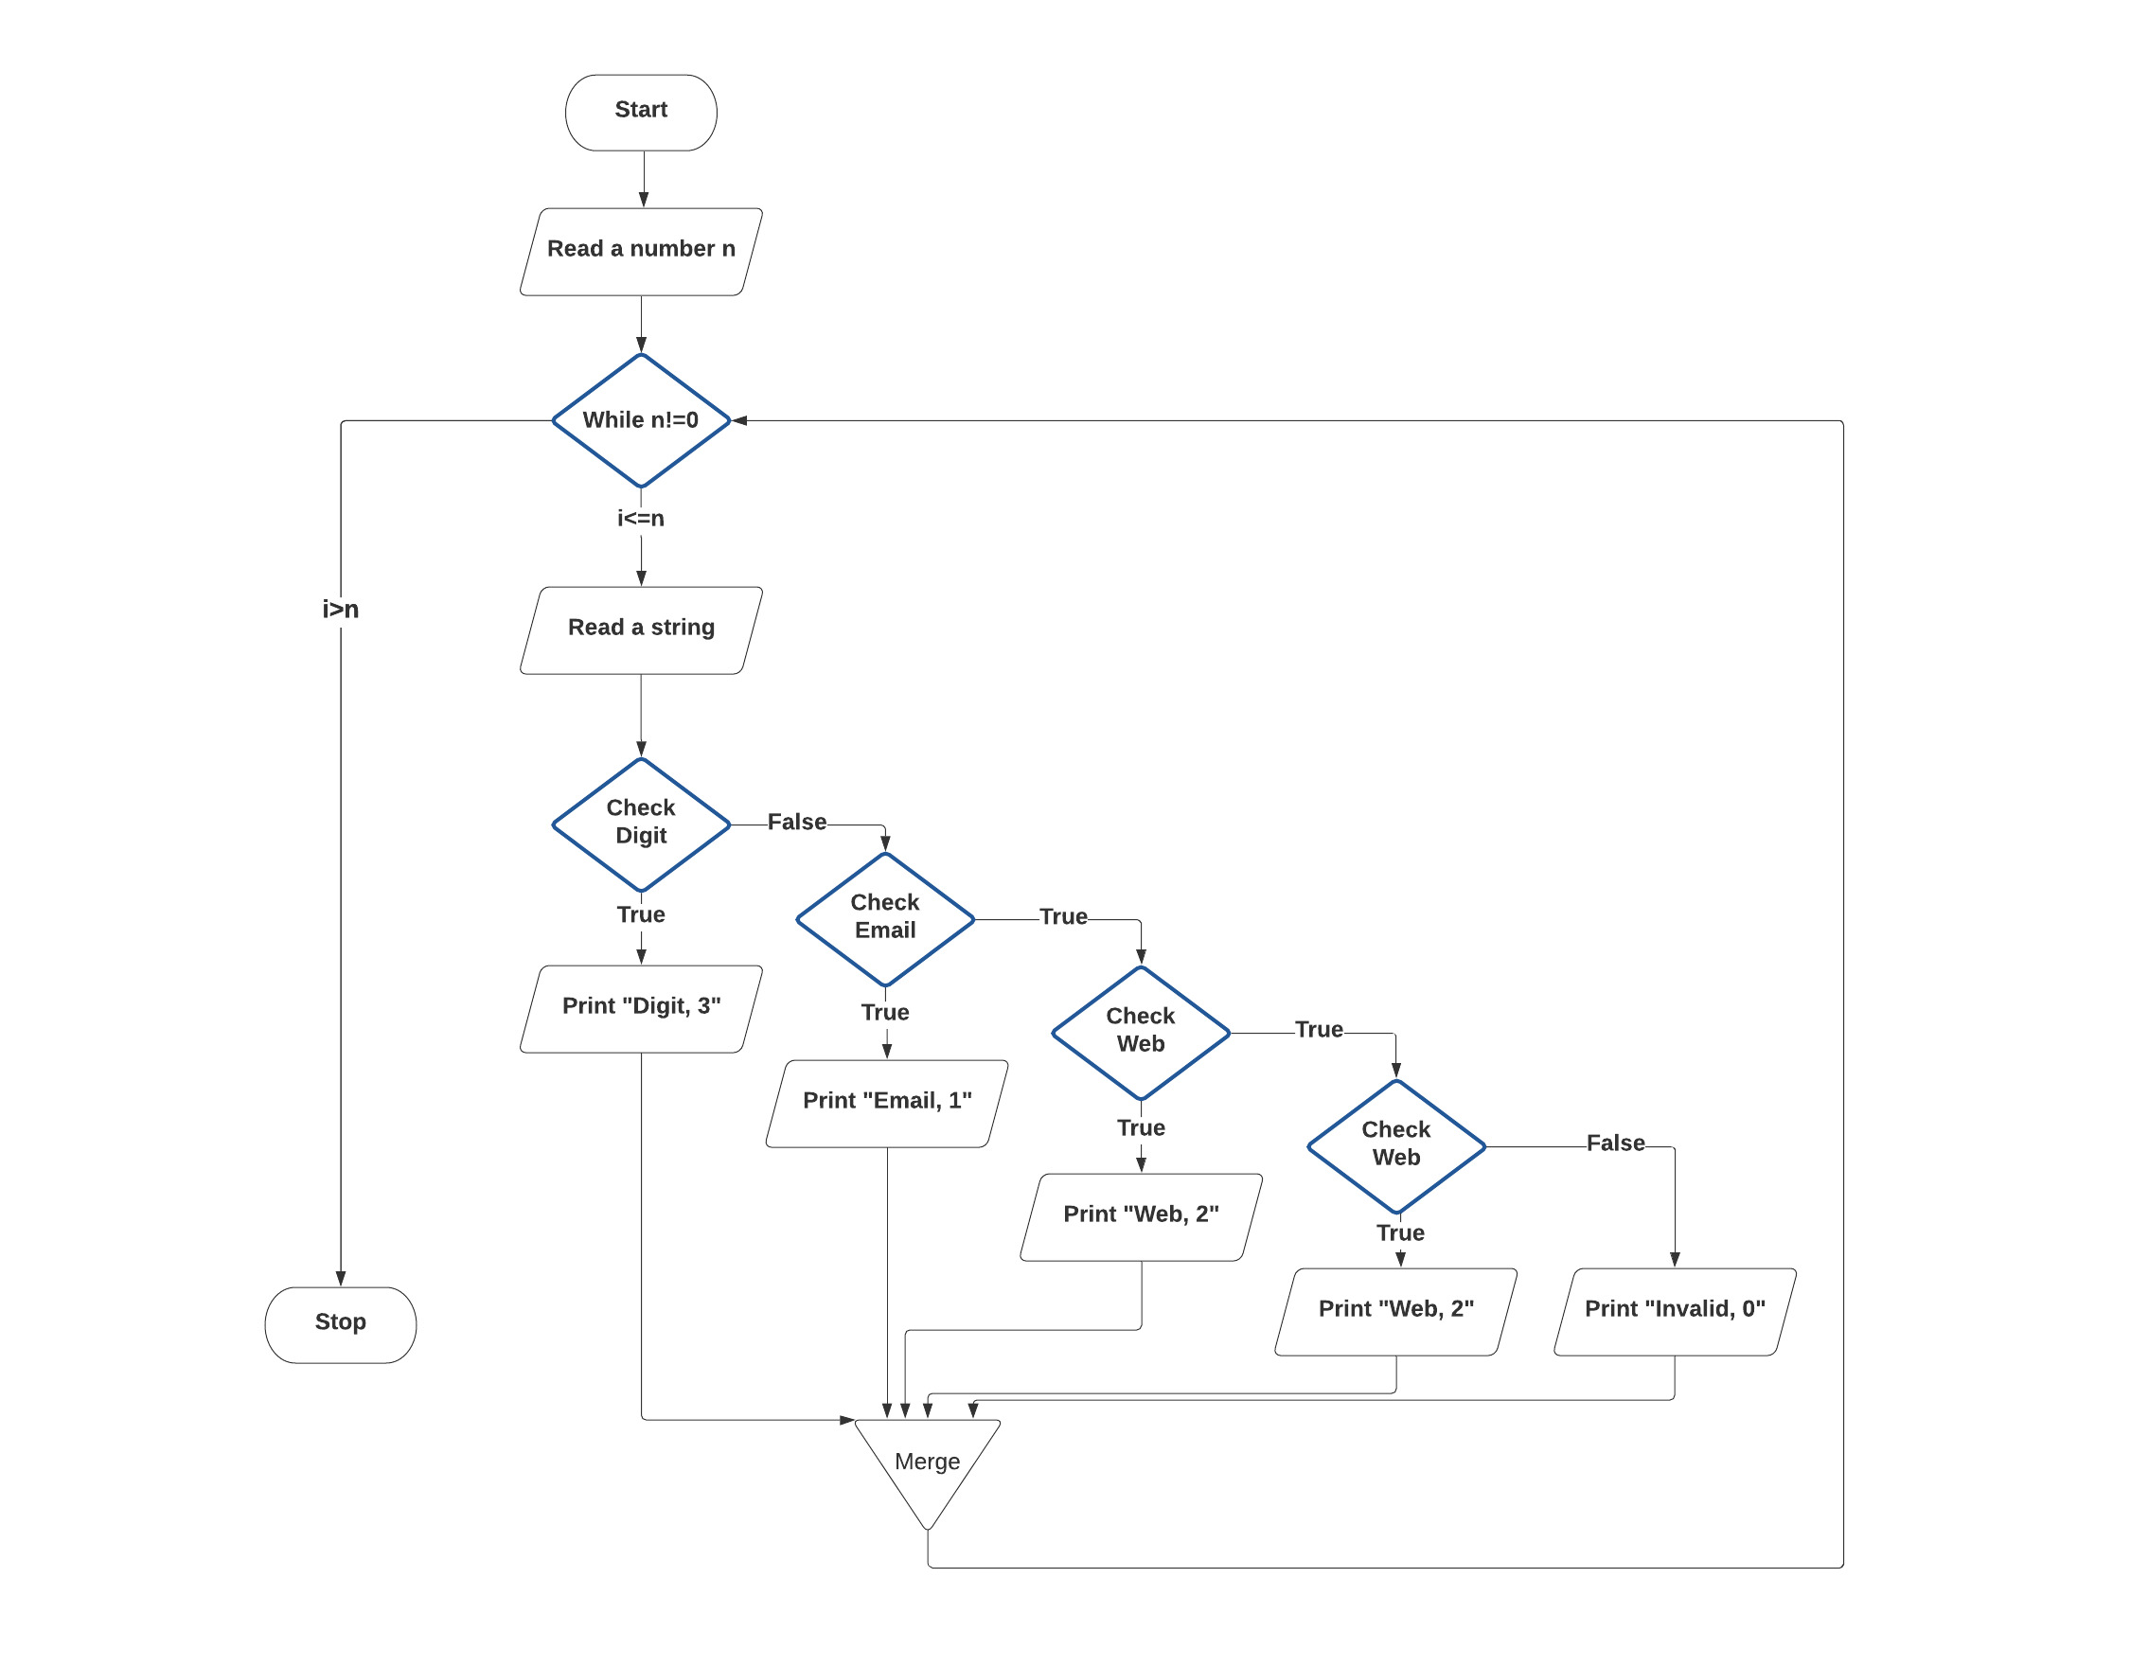
Flowchart

Slide 20
References
https://www.onlinegdb.com/online_c_compiler
https://educatech.in/c-program-to-recognize-strings-under-a-ab-abb-2/
https://lucid.app/lucidchart/
https://www.geeksforgeeks.org/write-regular-expressions/
https://regexr.com/
www.youtube.com/
www.google.com/
THANK YOU

